Slide 1
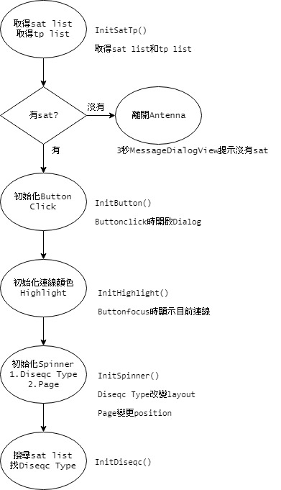
onCreate
InitSatTp()
取得
Sat list
Tp List
Sat Name String List
Tp Name String List

Slide 2
onCreate MessageDialogView
MessageDialogView
Delay 3秒
Show “No Sat List”
dialogEnd做finish()

Slide 3
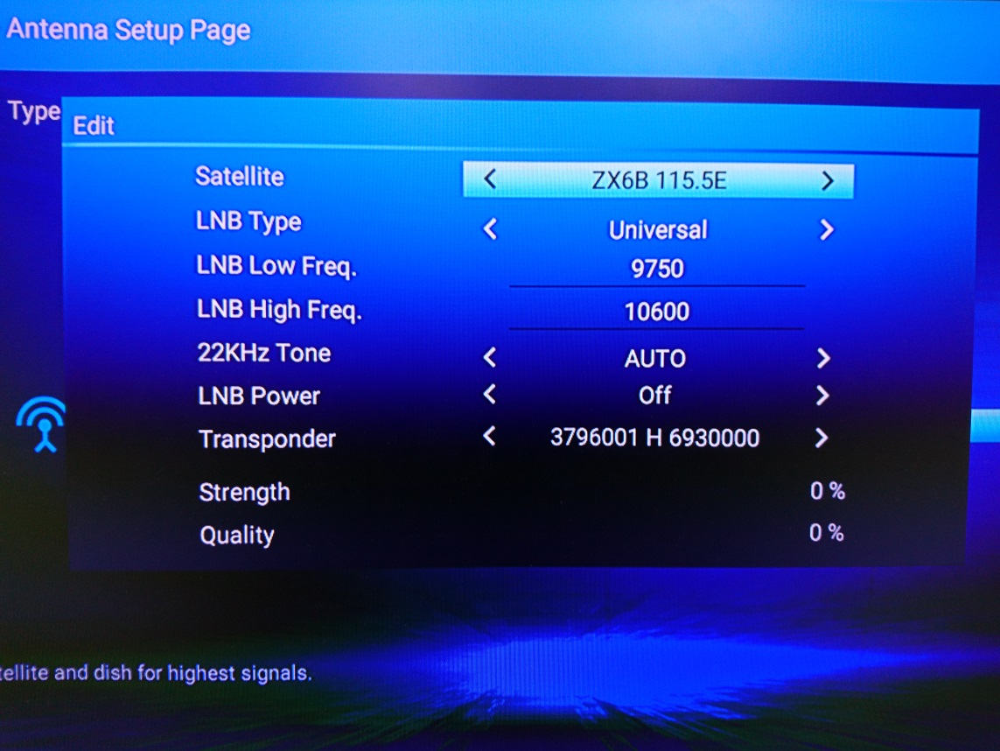
onCreate
InitButton()
開啟Edit Diseqc10 Dialog
Diseqc OFF
Diseqc 1.0
開啟Edit Diseqc12 Dialog
Diseqc 1.2

Slide 4
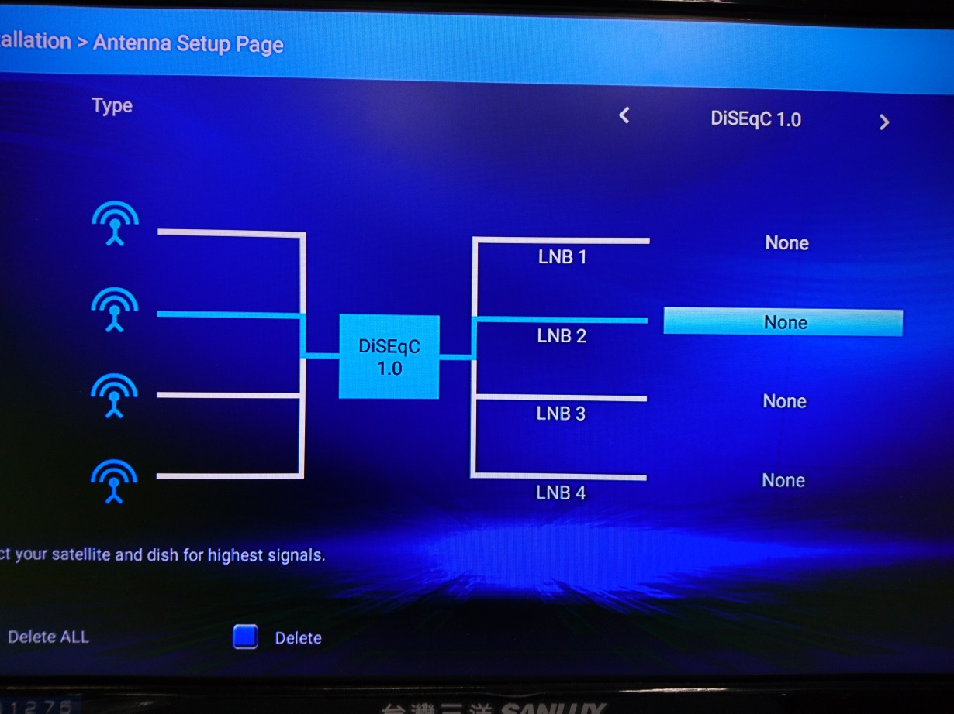
onCreate
InitHighlight()
Button
藍色, focused
白色, unfocused

Slide 5
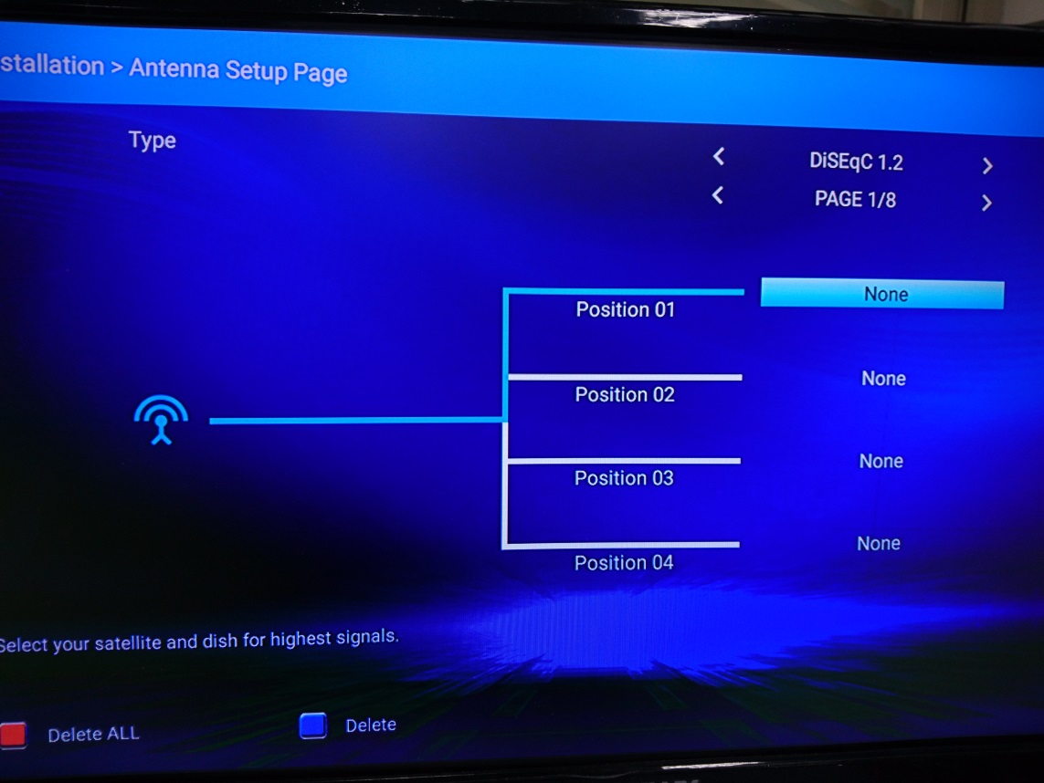
onCreate
InitSpinner()
Diseqc Type改變layout
Diseqc Off
Diseqc 1.0
Diseqc 1.2
改變position
Page 1~8

Slide 6
onCreate
InitDiseqc()
找Diseqc Type
InitDiseqcType
Diseqc 1.0
  diseqcType = 1
  diseqcUse = 1
Diseqc 1.2
  diseqcType = 2
  positionIndex != 0
Diseqc Off
  沒有符合的條件

Slide 7
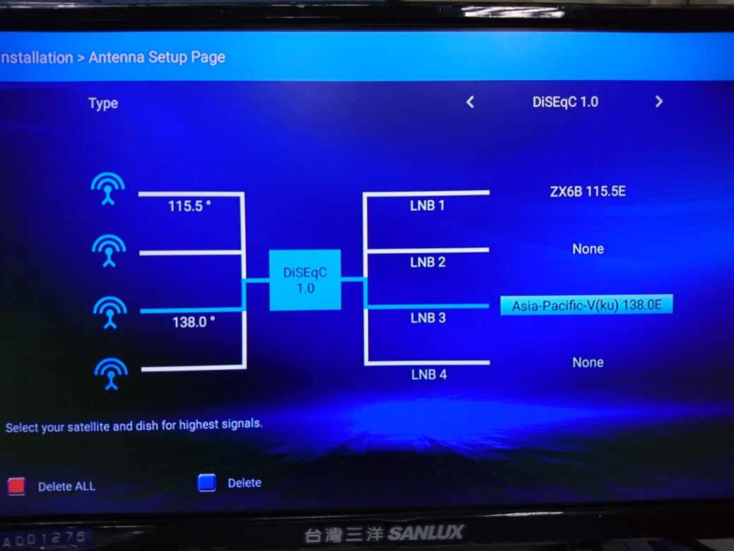
onCreate
InitDiseqc()
顯示button的sat
InitDiseqc10
檢查Port，Antenna.getDiseqc()
InitDiseqc12
檢查Position，getPositionIndex()
InitDiseqcOff
不是1.0也不是1.2，指定第0個sat

Slide 8
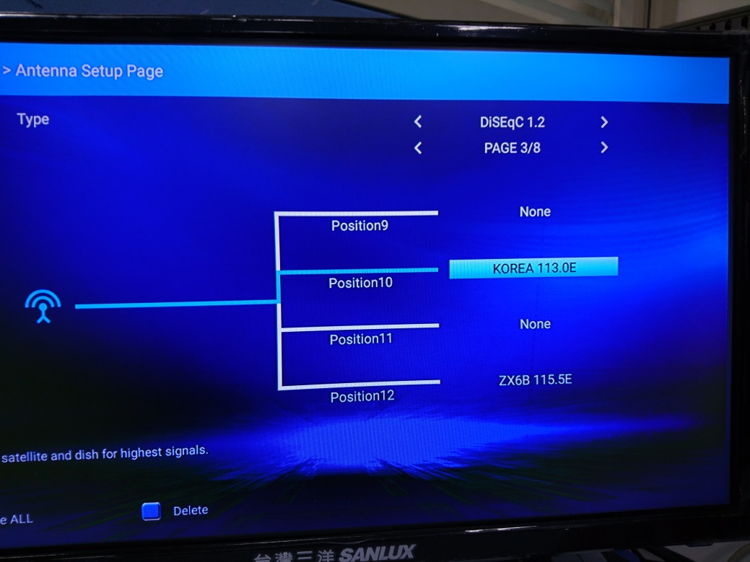
onCreate
InitDiseqc()
顯示button的sat
InitDiseqc10
檢查Port，Antenna.getDiseqc()
InitDiseqc12
檢查Position，getPositionIndex()
InitDiseqcOff
不是1.0也不是1.2，指定第0個sat

Slide 9
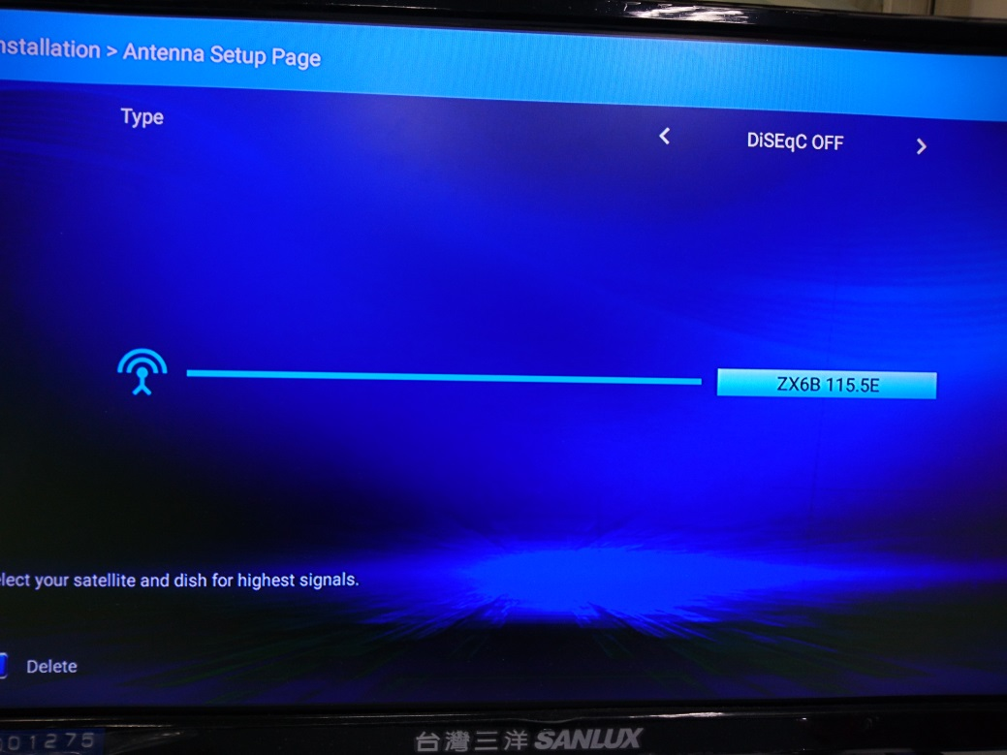
onCreate
InitDiseqc()
顯示button的sat
InitDiseqc10
檢查Port，Antenna.getDiseqc()
InitDiseqc12
檢查Position，getPositionIndex()
InitDiseqcOff
不是1.0也不是1.2，指定第0個sat

Slide 10
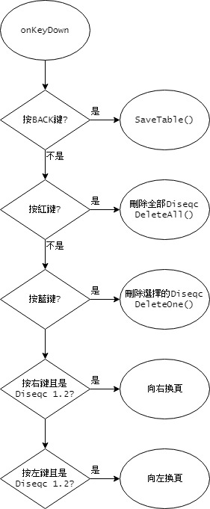
onKeyDown
Key
BACK: SaveTable()
RED: DeleteAll()
BLUE: DeleteOne()
RIGHT: Page Spinner setSelection()
LEFT: Page Spinner setSelection()

Slide 11
onKeyDown
DeleteAll()
Diseqc Off沒有Delete All
清空Diseqc 1.0
setText “None”
setDiseqcUse(0)
清空Diseqc 1.2
setText “None”
setPositionIndex(0)

Slide 12
onKeyDown
DeleteOne()
Diseqc Off / Focused TextView
setText “None”
Diseqc 1.0 / Focused TextView
setText “None”
setDiseqcUse(0)
Diseqc 1.2 / Focused TextView
setText “None”
setPositionIndex(0)

Slide 13
onKeyDown
換頁
Diseqc 1.2 / Focused TextView
向右換頁
Index超過8頁歸0
Page spinner setSelection(index++)
向左換頁
Index小於0設最後一頁
Page spinner setSelection(index--)

Slide 14
On Click Button
Diseqc 1.0 / Diseqc Off
Diseqc 1.2
EditDiseqc10Dialog()
EditDiseqc12Dialog()

Slide 15
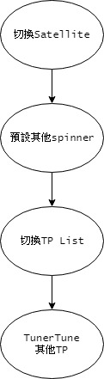

Diseqc 1.0 / Diseqc Off Dialog
On Item Selected
Satellite, InitSpinnerSat()
Spinner
替換所有TP List
TunerTune

Slide 16
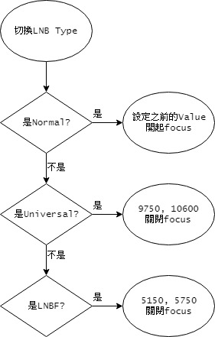
Diseqc 1.0 / Diseqc Off Dialog
On Item Selected
LNB Type, InitSpinnerLNBType()
LNB_TYPE_NORMAL
LNB_TYPE_UNIVERSAL
LNB_TYPE_LNBF

Slide 17
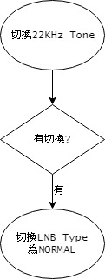
Diseqc 1.0 / Diseqc Off Dialog
On Item Selected
22KHz Tone, InitSpinner22kTone()
LNB_TYPE_NORMAL

Slide 18
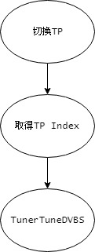
Diseqc 1.0 / Diseqc Off Dialog
On Item Selected
Transponder, InitSpinnerTP()
TunerTuneDVBS

Slide 19
Diseqc 1.0 / Diseqc Off Dialog
Runnable
InitProgressBar()
TunerGetLockStatus
TunerGetStrength
TunerGetQuality

Slide 20
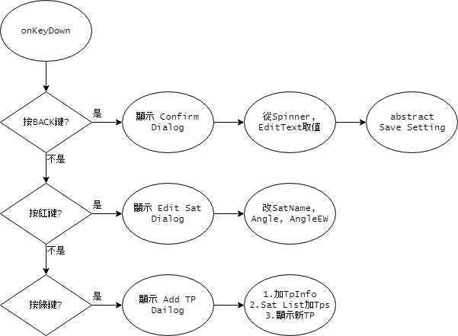
Diseqc 1.0 / Diseqc Off Dialog onKeyDown
Confirm Dialog
Sat
LNB Type
22K Tone
LNB Power
Low Freq
High Freq
Abstract SaveSetting()
Edit Sat Dialog
setSatName
setAngle
setAngleEW
Add TP Dialog
setSatId
setTuner_id
setFreq
setSymbol
setPolar

Slide 21
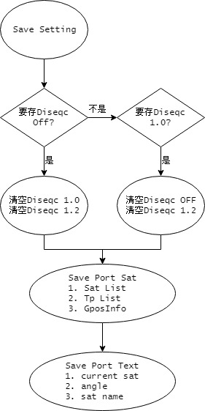
Diseqc 1.0 / Diseqc Off Dialog
SaveSetting
清空Diseqc, EmptyDiseqc()
清空Diseqc Off, button.setText(NONE)
清空Diseqc 1.0, setDiseqcUse(0)
清空Diseqc 1.2, setPositionIndex(0)
存設定, SavePortSat()
HISI: SatInfoUpdate() / PESI: SatInfoSaveList()
TpInfoSaveList()
GposInfoSave()
修改TextView, SavePortText()
存目前Sat Index
修改Angle
修改Sat Name

Slide 22
Diseqc 1.0 / Diseqc Off Dialog
SaveSetting
清空Diseqc, EmptyDiseqc()
清空Diseqc Off, button.setText(NONE)
清空Diseqc 1.0, setDiseqcUse(0)
清空Diseqc 1.2, setPositionIndex(0)
存設定, SavePortSat()
HISI: SatInfoUpdate() / PESI: SatInfoSaveList()
TpInfoSaveList()
GposInfoSave()
修改TextView, SavePortText()
存目前Sat Index
修改Angle
修改Sat Name

Slide 23
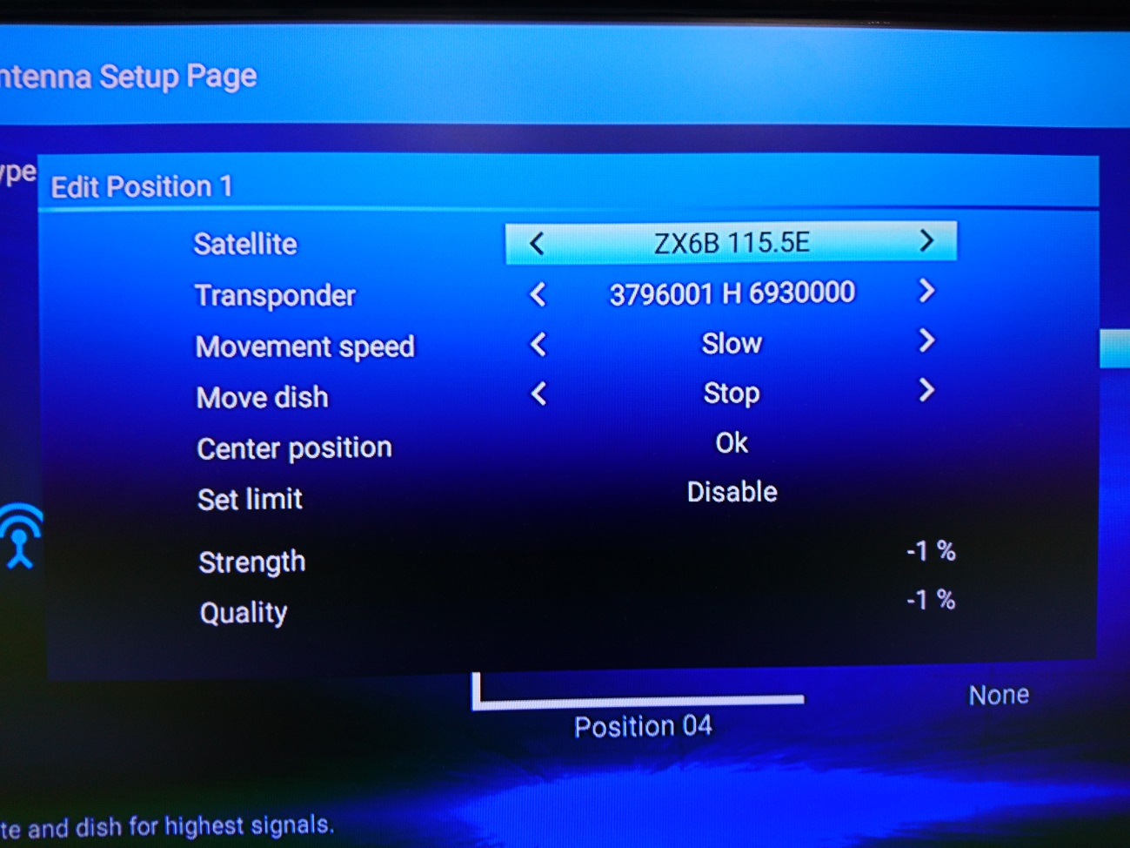
Diseqc 1.2 Dialog
InitSpinnerSat(): On Item Selected
Satellite, InitSpinnerSat()
Spinner
替換所有TP List
TunerTune

Slide 24
Diseqc 1.2 Dialog
InitSpinnerTP(): On Item Selected
Transponder, InitSpinnerTP()
TunerTuneDVBS

Slide 25
Diseqc 1.2 Dialog
InitSpinnerMoveDish(): On Item Selected
Move Dish
Stop
W << Moving
Moving >> E

Slide 26
Diseqc 1.2 Dialog
InitSetLimit(): On Click
Set Limit
開啟Limit Setup Dialog

Slide 27
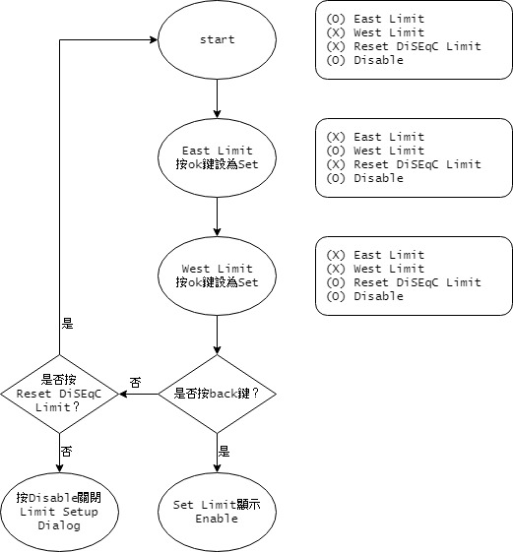
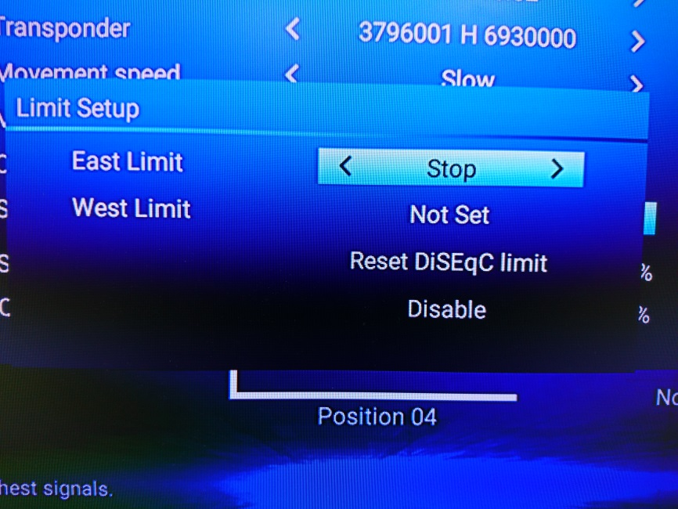
Limit Setup Dialog
East Limit
Stop
W << Moving
Moving >> E
Set
Not Set

Slide 28
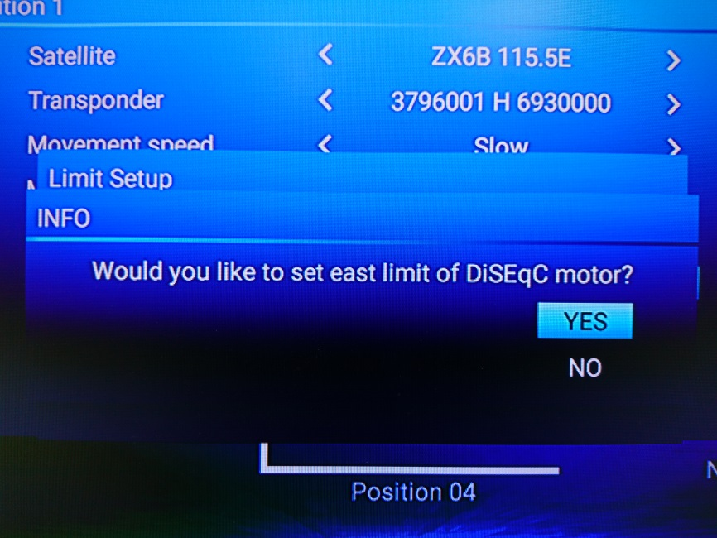
Limit Setup Dialog
East Limit
Stop
W << Moving
Moving >> E
Set
Not Set

Slide 29
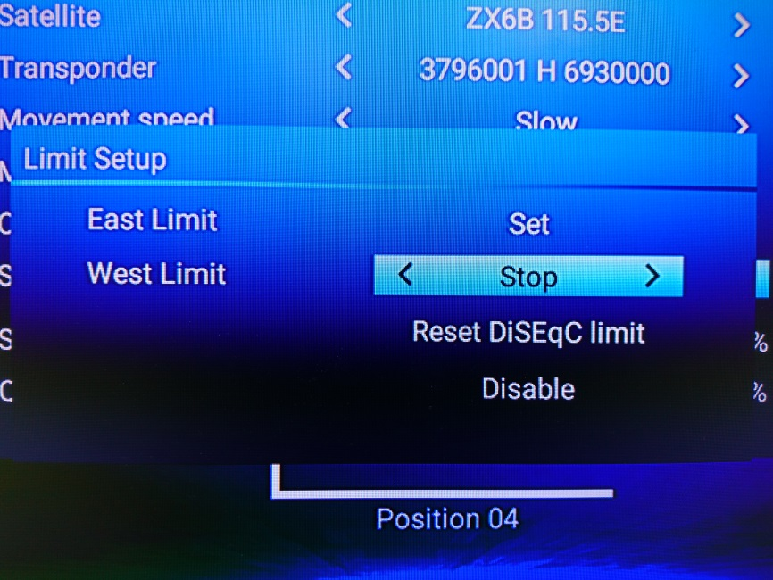
Limit Setup Dialog
East Limit
Stop
W << Moving
Moving >> E
Set
Not Set

Slide 30
Limit Setup Dialog
West Limit
Stop
W << Moving
Moving >> E
Set
Not Set

Slide 31
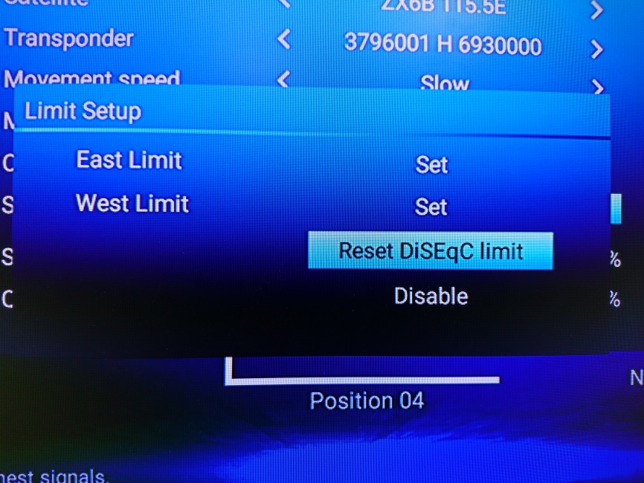
Limit Setup Dialog
West Limit
Stop
W << Moving
Moving >> E
Set
Not Set

Slide 32
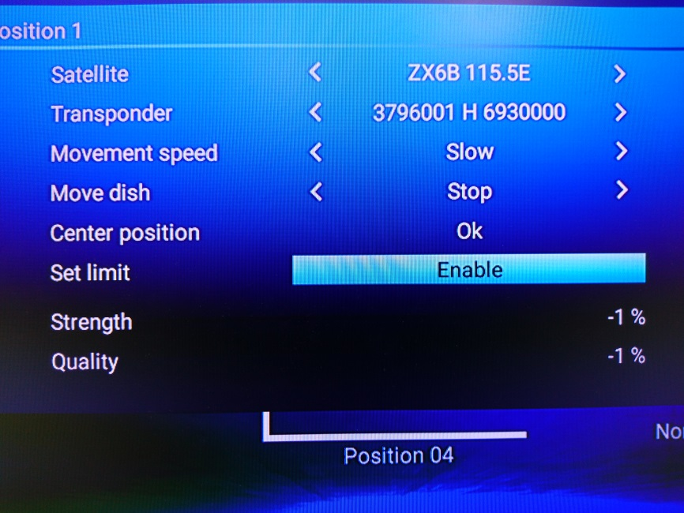
Limit Setup Dialog
Set Limit: Enable

Slide 33
Limit Setup Dialog
回到未設定狀態
East Limit
Stop
W << Moving
Moving >> E
Set
Not Set

Slide 34
Diseqc 1.2 Dialog
Other
跟Diseqc 1.0 / Diseqc Off 相同
Progress Bar
Edit Sat
Add Tp

